Slide 1
Data Decisions 101
Behavior/Mental Health Technical Assistance Center
Marshall University

Slide 2

Learning Outcomes
Realize data’s role in school improvement
Determine how to find issues and red flags in data that can be addressed
Create problem and goal statements based on your data
Use goal statements to determine reasonable, controllable solutions based on your problem and goal statements
Have a better understanding of the data-inspired decision-making process
Increase your confidence in your data-based abilities

Slide 3
What You Will Need
Your school behavior data
  Should show behavior frequency, location of behaviors, time of day, specific students, etc.
Worksheets/Charts to organize your data as you go through the process
  Example: Drill Down Worksheet
An open-mind to a new, research-based process

Slide 4
Basics of Data
“Think of educational data as a machine that receives and uses inputs to help run the educational process, producing outputs that include things like progress, success, and achievement. Data use depends on critical inputs from the parent, teacher, student, district, and state. (Garner, n.d.)”
Basically, data is what is produced from the various tests, reporting, observations, etc. in schools which can then be used to make decisions, measure progress, and reach other goals.
Data shows patterns
  The brain is wired to notice and use patterns
  We notice when there is an outlier/difference in the pattern
  Data is a pattern, it is predictable
  When the data strays from the predicted pattern, the brain is wired to notice

Slide 5
Basics of Data - Example
Average office referrals by day of the week
  Monday – 15, Tuesday – 19, Wednesday – 17, Thursday – 32, Friday – 11
  Which day of the week sticks out to you?

Slide 6
Basics of Data - Example
Imagine the circles are observation records
  Which one sticks out as being different?
Trust your brain

Slide 7
Myths and Truths about Data
Data/Data informed decisions are……
Data/data informed decisions aren’t…...
Patterns
About keeping it simple
Focused
A driving force for improvement
A cyclical process
Diverse
Complex equations that you need a statistics degree to understand
Linear
Just numbers
Is only test scores

Slide 8
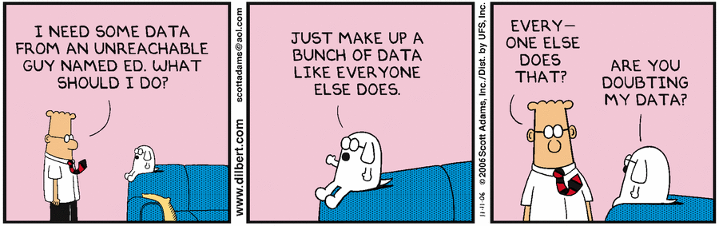
Considerations to Be Made
Is everyone submitting their data to the same place? Is everyone submitting data in general?
Does everyone have the same definitions of the data elements?
  For example: Does everyone inserting data have the same definition and understanding of insubordination?
  Consider what might need to be done to make sure that definitions and understandings of behaviors are consistent.

Slide 9
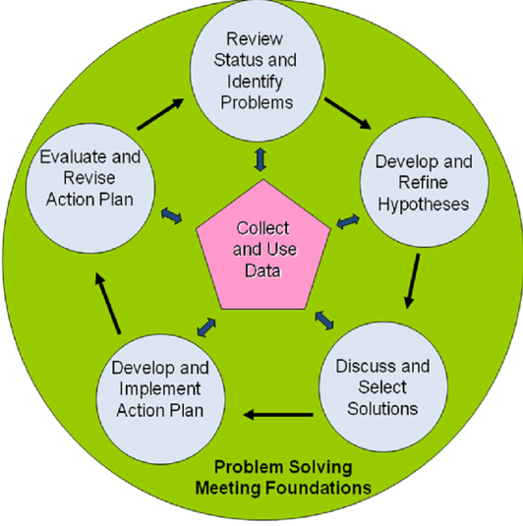
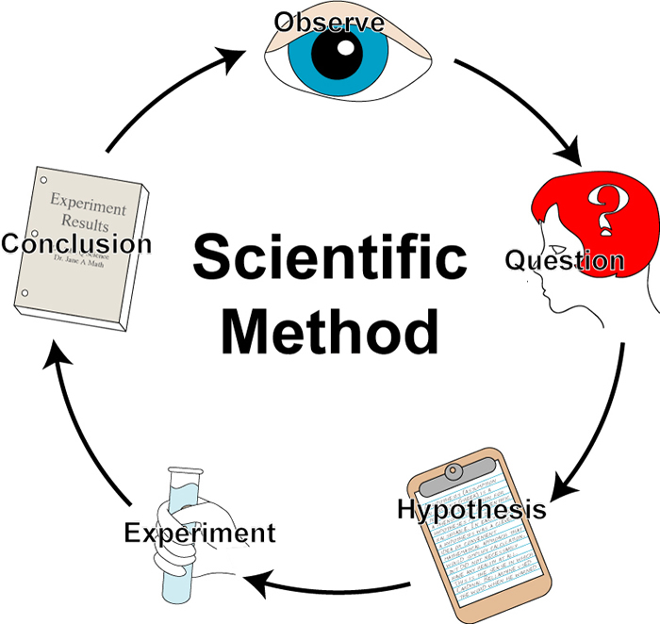
“Different” Methods of Data Collection
TIPS
Scientific Method
IT’S ALL A NATURAL INQUIRY PROCESS

Slide 10

“Step” 1
“Observe,” “Review Status,” “Identify Problems”
Where are you finding your data?
  WVEIS
  Surveys
  Test Scores
  Observation logs
Doing the deep dives of the data
  Looking through the numbers, observations, etc. and looking at the patterns
  Figuring out where that pattern is disrupted
  What makes you go “huh…,” scratch your head, wonder what is different about that element
  Looking at patterns and making comparisons

Slide 11
“Step” 1
Importance of those previously mentioned considerations
  Difficult to see patterns and red flags if not all the data is there, or entry was not consistent
What can you compare? What pattern can you create?
  School Level – comparing classrooms, times of day, groups of students, locations in the school
  District Level – comparing data points between schools in a district or a school to a district average
  State Level – comparing data points of schools or districts to a state average
  National Level - comparing data points of a school, districts, or state to a national average
  Depends on what you have access to, the contexts, and what you feel will be best

Slide 12
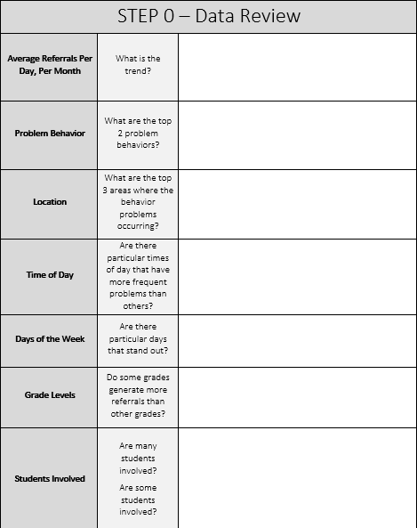
“Step” 1 Resources
Step 0 of the Data Drill Down Worksheet
  Helps organized your thoughts and observations
Video on identifying problems: https://www.pbis.org/video/problem-identification-in-team-initiated-problem-solving-tips

Slide 13
“Step” 1 Activity
Look at your data from this year up until this point and highlight:
  Things that stick out to you
  Things that make you scratch your head
Fill out the Step 0 section of the drill down sheet with that information

Slide 14

“Step” 2
What do you do once you find your “hmm….” data point?

Slide 15
“Step” 2
Big 5 method of problem identification
  Who? Who is the data point referring to? (4th grade? 7th grade girls? Students with IEPs?) Who is reporting that data? (Is only Ms. Smith reporting those behaviors?)
  What? What is the behavior or action the data point is referring to? (Defiance? Skipping Class?)
  When? When is the data point referring to? (August? Spring? 9:30-10:30?)
  Where? Where is the data point referring to? (Playground? Classroom? Hallway?)
  Why? Why do you think this is happening? Careful balance of using reasoning and observations without judging. Might not be the ultimate reason but helps provide guidance. (Do you think students are trying to avoid doing tasks? Are students fighting over playground equipment?)

Slide 16
“Step” 2
PROBLEM STATEMENTS NEED TO BE SPECIFIC
  We have an issue with aggressive behaviors VS we have an increase in aggressive behaviors in 4th grade boys in mornings in September on the playground because they are fighting over sports equipment
  Broad issues statements can become messy and overwhelming quickly…
  Better to repeat the inquiry process multiple times than try to tackle it all at once
  Similar issues might ultimately need different solutions depending on the time, location, group, etc.

Slide 17
“Step” 2
Head scratching data point: In September there is a spike of problem behaviors between 9:30 and 10:30
Who: Grades 4 and 5
What: Problem Behaviors - Defiance
When: September and 9:30-10:30
Where: Classroom
Why: Perceived motivation: task avoidance
Issue Statement: In September there were a group of ten 4th and 5th grade students referred for minor defiance in the classroom during the morning classroom period (8am-9:30am) in order to avoid tasks.
Specific Goal Statement: By the end of November, the team would like to see less than 5 referrals per month from 4th and 5th graders in the classroom before first recess (9:30am).

Slide 18
“Step” 2 Resources
SWIS Drill Down Worksheet: https://files.pbisapps.org/pub/pdf/SWIS-Drill-Down-Worksheet.pdf
Big 5 Data ODR Presentation: http://pbismn.org/documents/summerinstitute/Tracking_Using_ODR_Data_Non_SWIS_Schools_6_19_12.pdf
Using discipline data presentation: https://pbismissouri.org/wp-content/uploads/2018/06/DBDM-Solution-Plan.pdf?x30198
Big 5 Data Review Sheet: https://pb4l.tki.org.nz/content/download/637/2514/file/Section%208-6%20data%20review%20guide%20template%20(PB4L-SW%20Tier%201%20manual).pdf
SMART Goals: https://www.samhsa.gov/sites/default/files/nc-smart-goals-fact-sheet.pdf
Video on Identifying Goals: https://www.pbis.org/video/identifying-goals-in-team-initiated-problem-solving-tips
All of these include information and/or forms to help organize your data to create those specific problem statements that you will examine further in the next steps

Slide 19
“Step” 2 Activity
Choose one of your “aha” moments from your data that you want to focus on
Use the Big 5 to make a precision data statement
Fill out the Data Drill Down Sheet “Step 1”
Based on your precise problem statement, create a goal statement

Slide 20
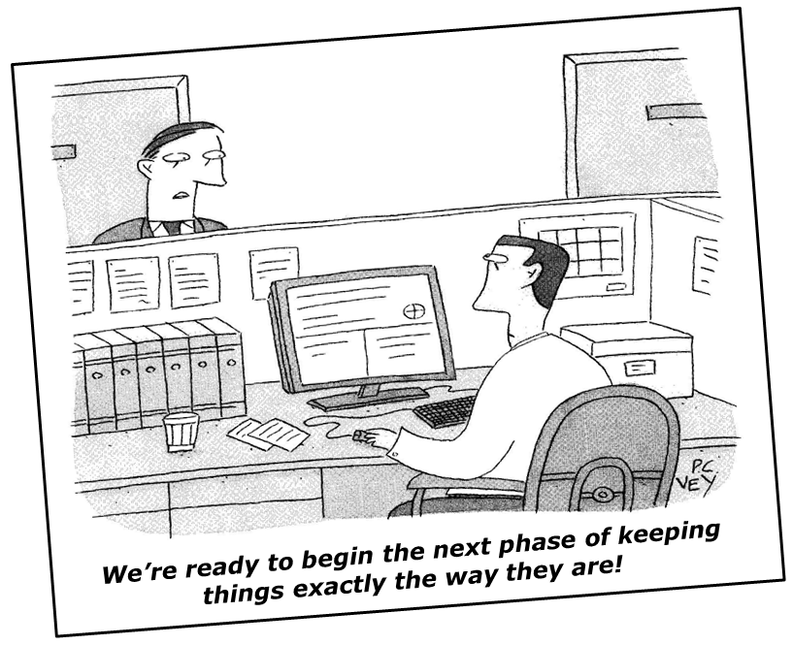
“Step” 3
We’ve got our problem statement and goals, what now?
  Brainstorm possible solutions
No magic solution or formula for what’s next
  Trial and error
  Intuition and experience
  Looking at other’s experiences

Slide 21
“Step” 3
Consider at what level the solution should be (General Data Decision Rules Handout)
  Individual Systems with Action Team Structure
  Targeted Group Interventions
  Classroom Systems
  Non-Classroom Setting Specific System
  School-wide System

Slide 22
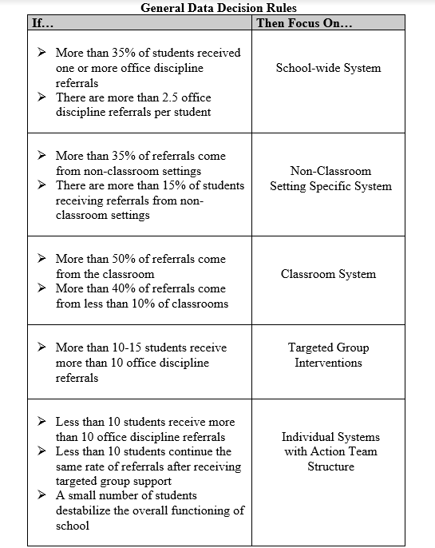

Slide 23
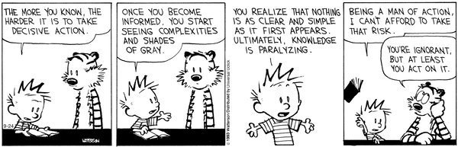
“Step” 3
Changes should be simple, manageable, and controllable
  Small changes over time will help you better determine how your changes are affecting outcomes
  If too many changes/too large of changes are made, it can be difficult to determine what is actually working and what is not

Slide 24
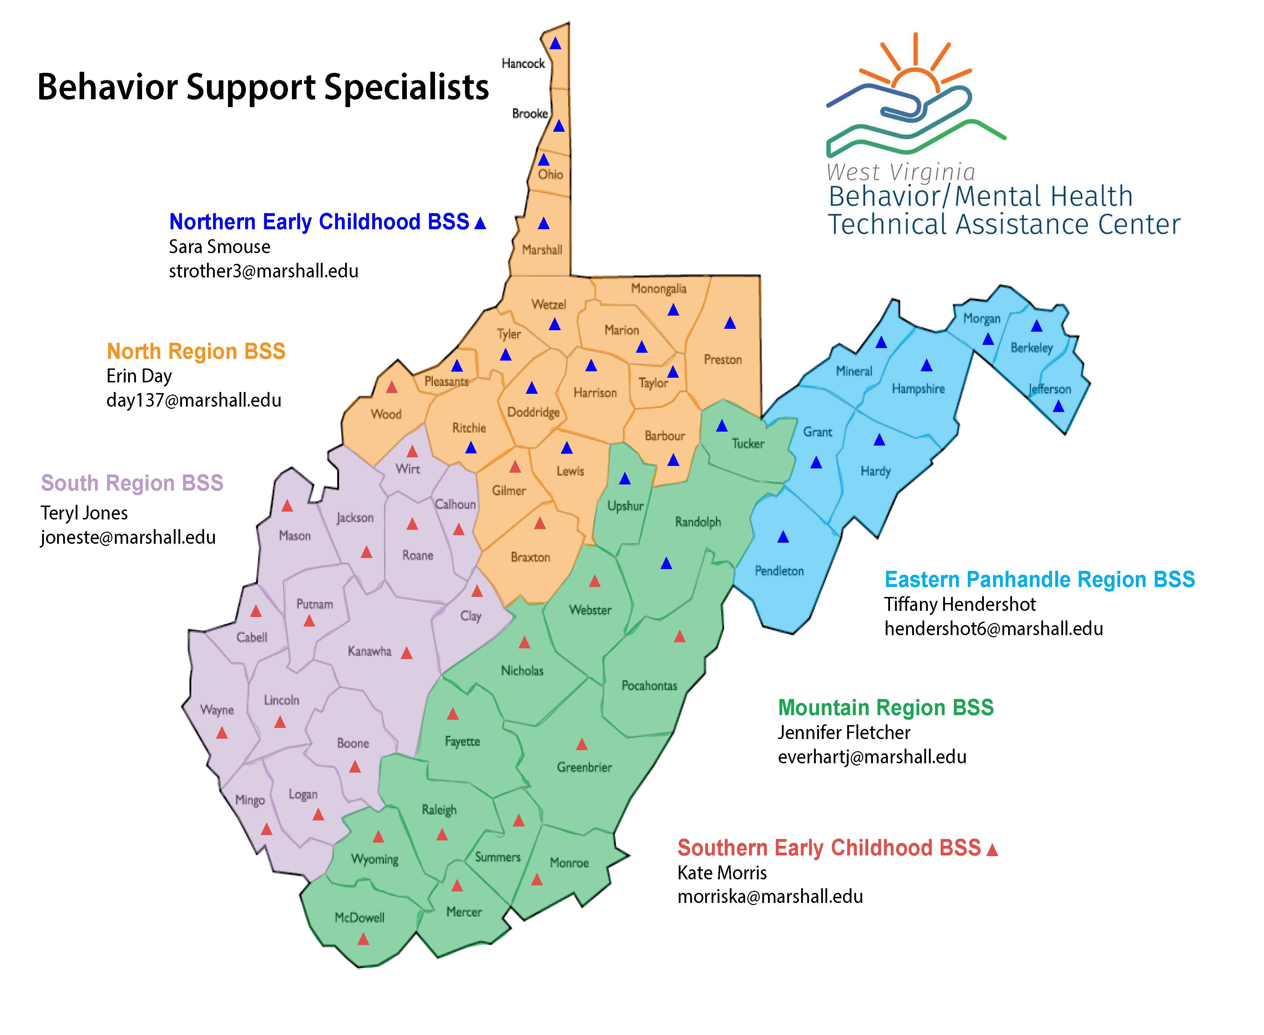
“Step” 3
Consider the steps for implementing the solution you decided to try
  Have a plan for steps
  Consider trainings that will need to be done
  Determine which resources and how much time you will need
  Figure out how you will make the changes with the students
  Will you have staff buy-in for the change?
  Figure out how you are going to measure progress towards your goal
  What other roadblocks could there be?
This is where your Behavior Support Specialist can help you!
AWARE BSS
Christy Fubio
kroll3@marshall.edu

Slide 25
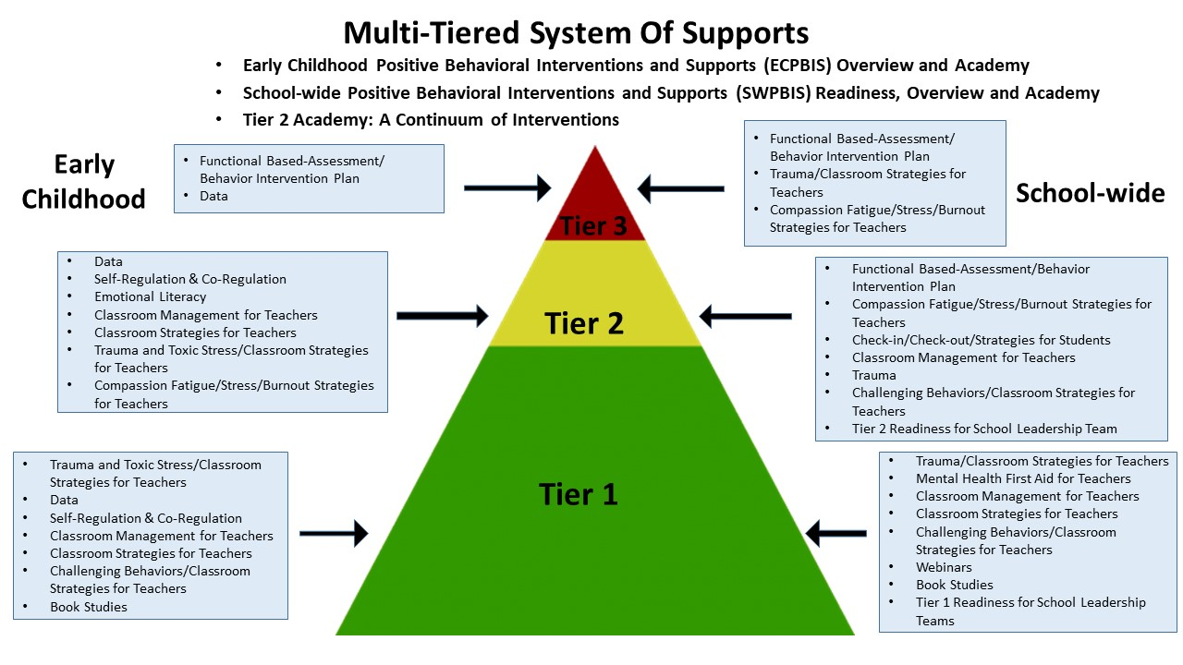

Slide 26
“Step” 3 Resources
“Solution Development” Section of Data Drill Down Worksheet: https://files.pbisapps.org/pub/pdf/SWIS-Drill-Down-Worksheet.pdf
Tips on using the data: https://www.edutopia.org/article/3-tips-use-data-effectively
BMHTAC Trainings: https://www.marshall.edu/bmhtac/training-menu/trainings-glance/
https://www2.ed.gov/programs/racetothetop/communities/bfk-rttt-communications-lessons-learned.pdf
Successfully Implementing Transformational Change: https://www.k12insight.com/trusted/change-schools-community-engagement/
Video on aligning solutions to problem statements: https://www.pbis.org/video/aligning-solutions-with-precise-problem-statements-in-tips
Video on implementing solutions with integrity: https://www.pbis.org/video/implement-solutions-with-integrity

Slide 27
“Step 3” Activity
Brainstorm some possible solutions based on your problem and goal statement
  Remember to consider:
    Timeframe
    Specifics steps that will need to be done to implement the solution
    How you will communicate the solution to others
    Who will do any trainings or professional development that needs to be done
    Changes that will need to be made with the students and how those will be introduced/taught
    Getting buy-in from staff
    Possible roadblocks that you will face
    How the change will be measured
Fill out the Steps 2 and 3 on the Drill Down Worksheet

Slide 28

“Step” 4
How do we know how well our solution is working?
Look back at the data!
  Is it changing?
  Is it approaching the goal? Getting further away?
  Is it fitting into the pattern more once the solution has been implemented?
  Compare data points before and after implementation
  If there is a change, was it most likely because of the change you made? Or was there another factor?

Slide 29
“Step” 4 Resources
Measuring Progress in Schools: https://edtech4beginners.com/2018/12/17/the-easiest-ways-to-measure-your-progress-in-school/
Video on monitoring solutions and comparing progress to goals: https://www.pbis.org/video/monitor-impact-of-solutions-and-compare-against-goal-in-team-initiated-problem-solving

Slide 30
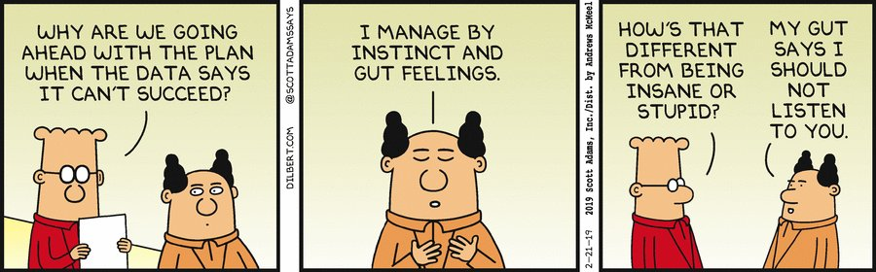
“Step” 5
Draw conclusions based on the data you collected and answers to the questions you asked
  Did we reach our goal? If not, was it because we did not implement it long enough? Or should we try something else?
    The brain wants to maintain the status quo, so change can take time!!
Gut feelings and instincts are important, but it should lead to more questions, not ignoring the data

Slide 31

“Step” 5
Decide your next steps based on your conclusions
  Should we continue implementing the solution and make adjustments?
  Or should we try a different solution?
  Should we continue the implementation and move on to the next problem from our data?

Slide 32

“Step” 5
Communication is key not only in the implementing steps, but also when drawing conclusions
  Help others see the importance of the decisions and changes that are being made
  Can help increase buy-in for future initiatives and changes

Slide 33
“Step” 5 Resources
Video on what to do after the monitoring stage: https://www.pbis.org/video/summative-evaluation-decisions-in-team-initiated-problem-solving

Slide 34
“Step” 4 and 5 Activity
These steps will need to come later.
For now, consider the following:
  What will you look at to determine the success of your solution? What data will you look at/collect?
  How often will you collect data?
  Who will be in charge of collecting/organizing the data?
  When will you come together to examine the data again?
  What would you consider a success?
  How will you communicate data at this point to the rest of the school/others?
Fill out Step 4 of the Drill Down Sheet

Slide 35
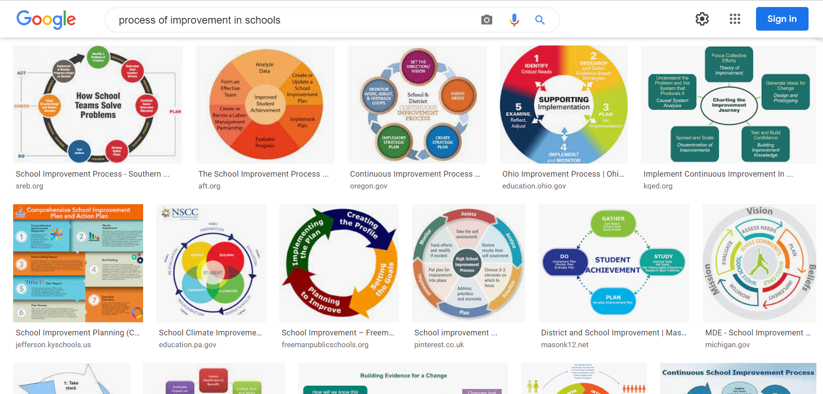
It’s a Cycle
It’s never “welp we met our goal, no more data-based decisions!!”
Once you decide if you should make adjustments to the implemented practice, if you are going to try to implement a different practice, or you move on to a new problem statement, go back to the appropriate step and keep on going!
“Excellence is the gradual result of always striving to do better” – Pat Riley
Notice that a Google Image search for “process of improvement in schools” brings up almost exclusively cycles, and rarely a linear process

Slide 36
Other Resources
Data-Based Decision Making: https://www.pbis.org/topics/data-based-decision-making
Data Analyst Worksheet: https://assets-global.website-files.com/5d3725188825e071f1670246/5dd43c17dc6c74f86fe4c8d8_Data%20Analyst%20Worksheet.docx
Video on using data to address discipline disproportionality: https://www.pbis.org/video/using-data-and-data-systems-to-address-discipline-disproportionality
Article on making data-based decisions in schools: https://www.tandfonline.com/doi/full/10.1080/00131881.2019.1625716

Slide 37

The “Lasso Way” of Data Analysis
Don’t Be Judgmental
Be Curious
Ask Questions

