Slide 1
CHECK-IN, CHECK-OUT Universal Tier 2 Behavior Intervention: A Quick Guide for Teachers
Notes:
Update this powerpoint with your school’s logo and other information. Make it your own!

Slide 2
Our School’s Current Data
Number of discipline referrals
Number of students receiving those referrals
Areas of the school with the most behavior concerns
Whatever Tier 1 data you want to share
Notes:
Update this slide so teachers can see the state of Tier 1 in the school and why you need Tier 2. This slide will need updated quarterly (or when you see changes)

Slide 3
What does Check-In, Check-Out do?
Provides structure in a student’s day
Creates accountability
Provides teacher feedback to student and parents
Creates internal motivation
Improves student behavior
Increases academic success
Creates a stronger home-school connection
Notes:
Review this with teachers so they buy-in to the intervention.

Slide 4
Who is Check-In, Check-Out for?
Students who do not meet our school’s
Tier 1 Expectations consistently.
(enter your school’s expectations here)
Be Respectful
Be Safe
Be Kind
(What is your school’s policy on CICO referral?)
*IT IS NOT FOR STUDENTS WHO ARE IN CRISIS*
Notes:
Explain how the decision is made to put students on the CICO intervention. Is it based on office referrals? How many? Whatever it is make it clear to staff how the decision is made. This will prevent too many students from being referred to Tier 2.

Slide 5
Daily Components
Check–In and Check-Out with a Facilitator
Any positive, reliable, caring adult in the school who has an interest in student’s success
Person must be available daily at beginning and end of day
Regular Feedback
Teacher during each class period will provide specific feedback to student
Family participation
(Decide how your school will communicate with parents)

Slide 6
Getting Started
Collect Baseline data on student for at least 3 days on the Daily Progress Report (DPR) before introducing the intervention
Use this to determine goal the first week
Decide who will be the students CICO Facilitator
Send a standard letter home to parents
Create the template of the DPR and make copies
Introduce student to CICO and teach how to earn points
Introduce student to school-wide Tier 2 reward system
Notes:
It is very important to take the time alone with the student to teach them about CICO. Review target behaviors and what a 2 looks like in every block through the day. Use this time to get the student excited about this new opportunity. Make sure your school has a Tier 2 reward system and the student understands how they will be able to use their points.

Slide 7
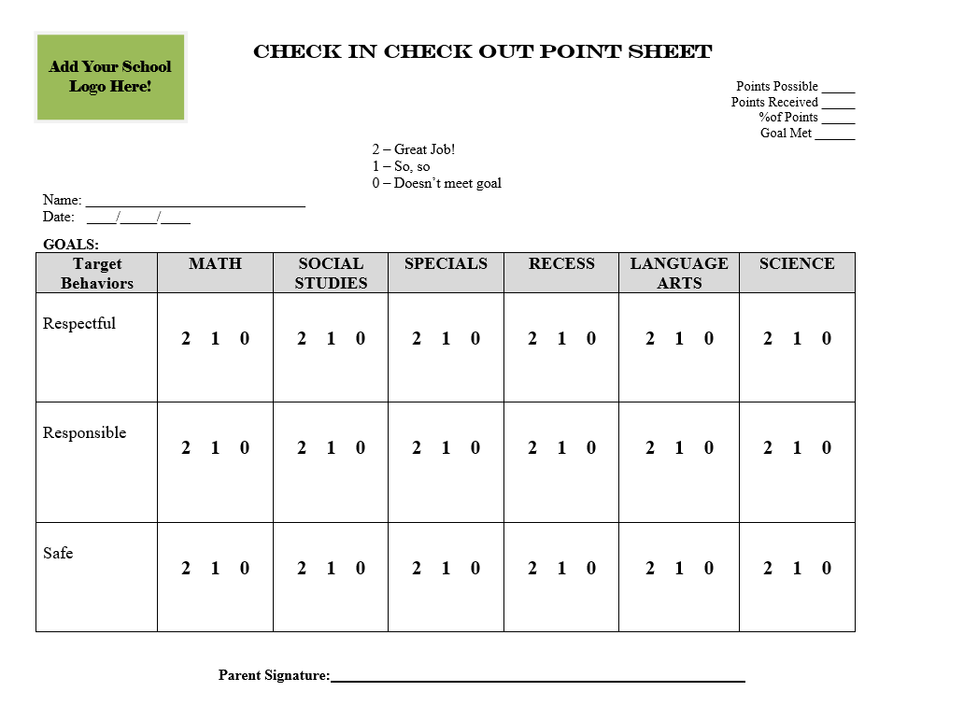
Insert your school’s
Daily Progress Report (DPR) here
Notes:
Explain what constitutes a 0,1 or 2 during this slide.

Slide 8
How does Check-In work?
CICO Facilitator is an identified adult that meets with the student first thing in the morning.
Discuss goal for the day
Predict hurdles for the day
Plan to remove hurdles
Write the goal at the top
Write in daily schedule
Teacher reviews the DPR when they return to class
* Teacher can be the CICO facilitator for student*

Slide 9
Teacher Feedback
Teacher circles in pencil during the time block and pen at end
Some schools ask teachers to initial next to the number to keep students honest. This is up to you.
Student takes the clipboard with DPR to every class
Lunch and Recess can be scored by teachers on duty
Student gets full points where behaviors are N/A during that time or environment (completes work during recess)
As students mature, they can self report their behavior
Teacher agrees with students score and gives specific feedback
Teacher disagrees with students score and they discuss to get to a mutually agreed upon score
*Make sure everyone that interacts with the student
knows they are on CICO and gives them
positive words to meet their goal*

Slide 10
BEHAVIOR SPECIFIC PRAISE
30 seconds or less!
Provide Specific Praise for Behavior:
Step 1: Identify the student or group
Step 2: Include a term of praise
Step 3: Describe/Acknowledge specific behavior/rule being recognized
Step 4: (best practice): Link to school-wide expectation
Step 5: (optional): Provide tangible reinforcement, DPR points, etc.
Non-examples:
“Brian is sitting in his seat.”
Saying “good job” without connecting to school-rule.
Giving ticket without saying anything
Only giving a ticket for “above and beyond” behavior
”Diane, Awesome! You are demonstrating Listening to the speaker, that's being ‘respectful!’”
“This whole table group cleaned up their lab area when the period bell rang. Well done! Way to show ‘responsibility.’”
MS Before & After Video Example: https://drive.google.com/file/d/0B1-B5Pl4nuDwbWUxMlpnM2pEc2M/view
The Wilson Way | Classroom Rules
Be Responsible | Stay on task Clean up area Apologize for mistakes
Be Respectful | Raise hand Listen to speaker Follow directions
Be Safe | Walk quietly Keep hands and feet to self
Notes:
Spend time giving opportunities to practice using behavior specific praise on each other. Presenter use it on attendees. “I love how you are paying attention to this presentation. It shows me that you care about these students and want to learn more strategies to help them.”

Slide 11
STEPS TO SPECIFIC AND CONTINGENT Error Correction:
1 minute or less!
Example: “Joe [privately and with sincere voice tone], I saw that you were talking to your neighbor during independent work time. The expectation during independent time is focus on your own work which is Doing Your Best. Go ahead and start on your work again, and I’ll stop by to catch you doing your best.”
2. Describe inappropriate behavior
1. Respectfully address student
3. Describe expected behavior/rule
4. Link to school-wide expectation on Matrix
5. End with encouragement
Notes:
Ask participants to make an error correction statement to share with the whole group. Are all components included? Is it brief? Is it linked to rule and expectation on the Matrix?

Slide 12
CHECK-OUT EXPLAINED
Students will Check-Out with their CICO Facilitator
Facilitator or student will tally their points and see if they reached their goal
Facilitator will use school’s Tier 2 reward system
Facilitator will file DPR and communicate to parents if the student met their goal
Do not send original home without a back-up
Parents are usually okay with a “met or did not meet goal today”

Slide 13
Daily Data Collection
Facilitator will maintain DPRs and give to CICO coordinator weekly
Keep the entire sheet or take a picture and e-mail to CICO coordinator
Look for trends (time of day or day of the week)
Ensure goal is realistic and attainable
Problem solve
* Do not send home the daily report without taking a picture or making a copy. Assume that it may not be returned.

Slide 14
Monthly Data Report
Monthly the CICO coordinator will input data into chart to review students progress with Tier 2 team
If student needs a Modified CICO target behaviors will be reviewed and updated as needed
Monthly data reports will be used in meetings to make decisions
Parents should receive a copy of monthly report

Slide 15
Notes:
Explain how to review this with students. Take particular notice to number of times student made the goal and how close they came on other days. Use this as a way to boost them for the next month. STAY POSITIVE!

Slide 16
Check-In, Check-Out Tips
If a student rips up their DPR discontinue it for the remainder of the day.
If the problem persists Tier 2 Team will need to discuss Modified CICO options
This is a POSITIVE behavior intervention
Do not consistently give zeros and expect behavior to improve
It is our job to identify when and where students are struggling then teach the skills they need to be successful

Slide 17
Tips Continued…
Buy-In is very important in the beginning
attainment of goal is essential the first week
Sometimes the goal may need adjusted at lunch to ensure it is still attainable
Do they need a morning and afternoon goal?
Have they already met their goal at lunch?
Do they have no chance of reaching their goal at lunch?
*DO NOT write any negative comments on the sheet.*

Slide 18
More Questions?
Ask your Tier 2 PBIS Team
Enter list of team members here!

